Slide 1





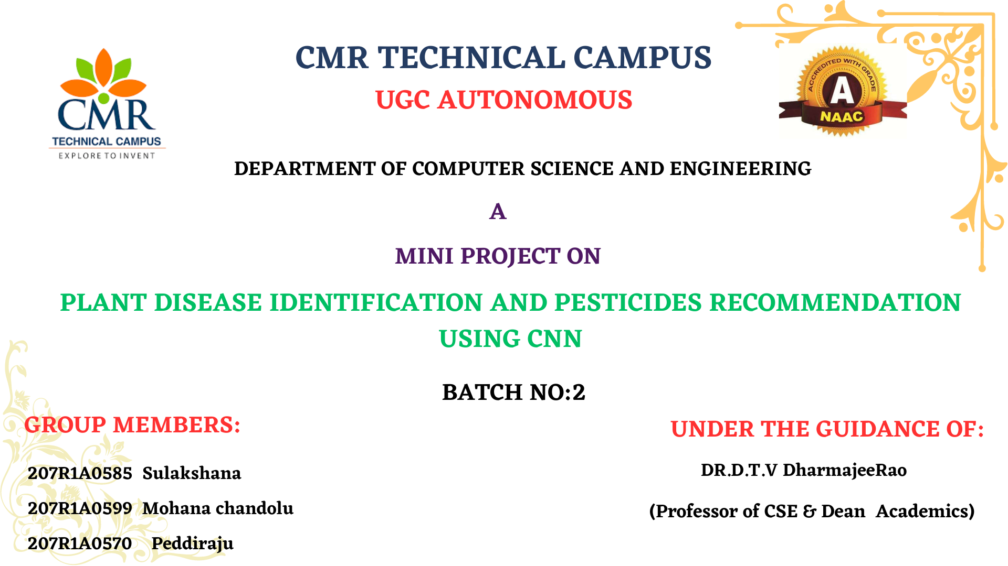
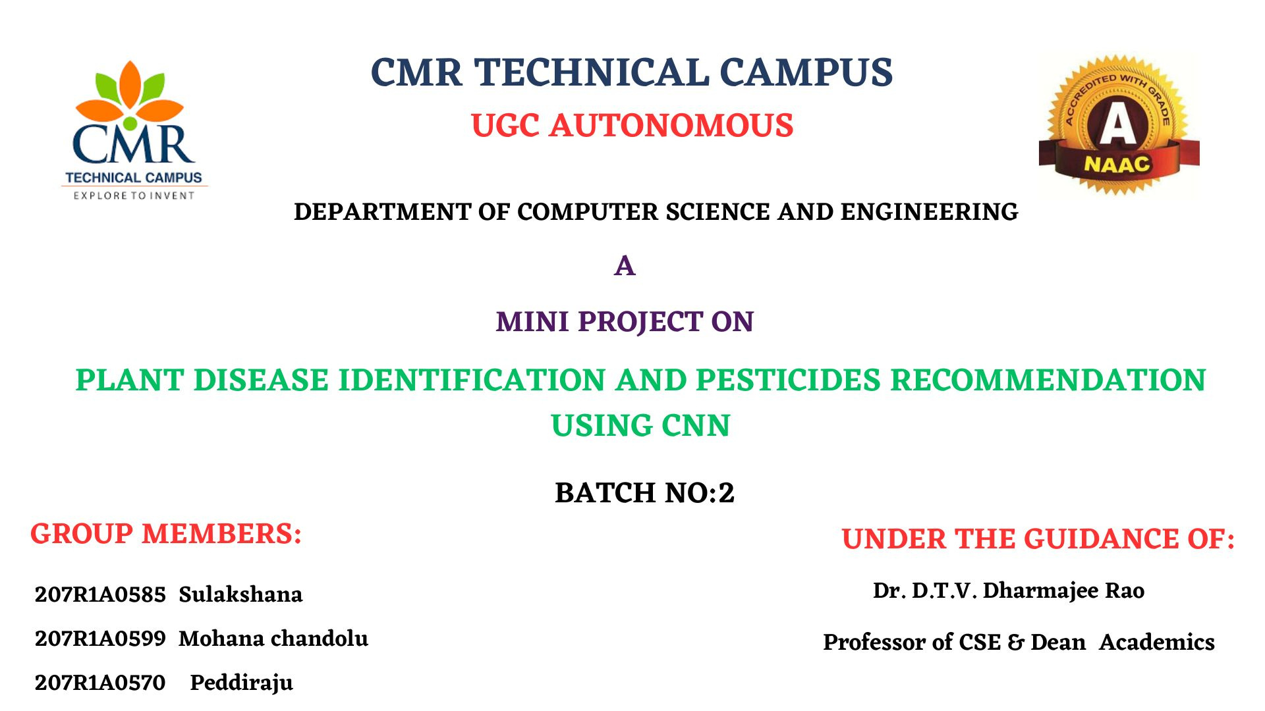




Slide 2
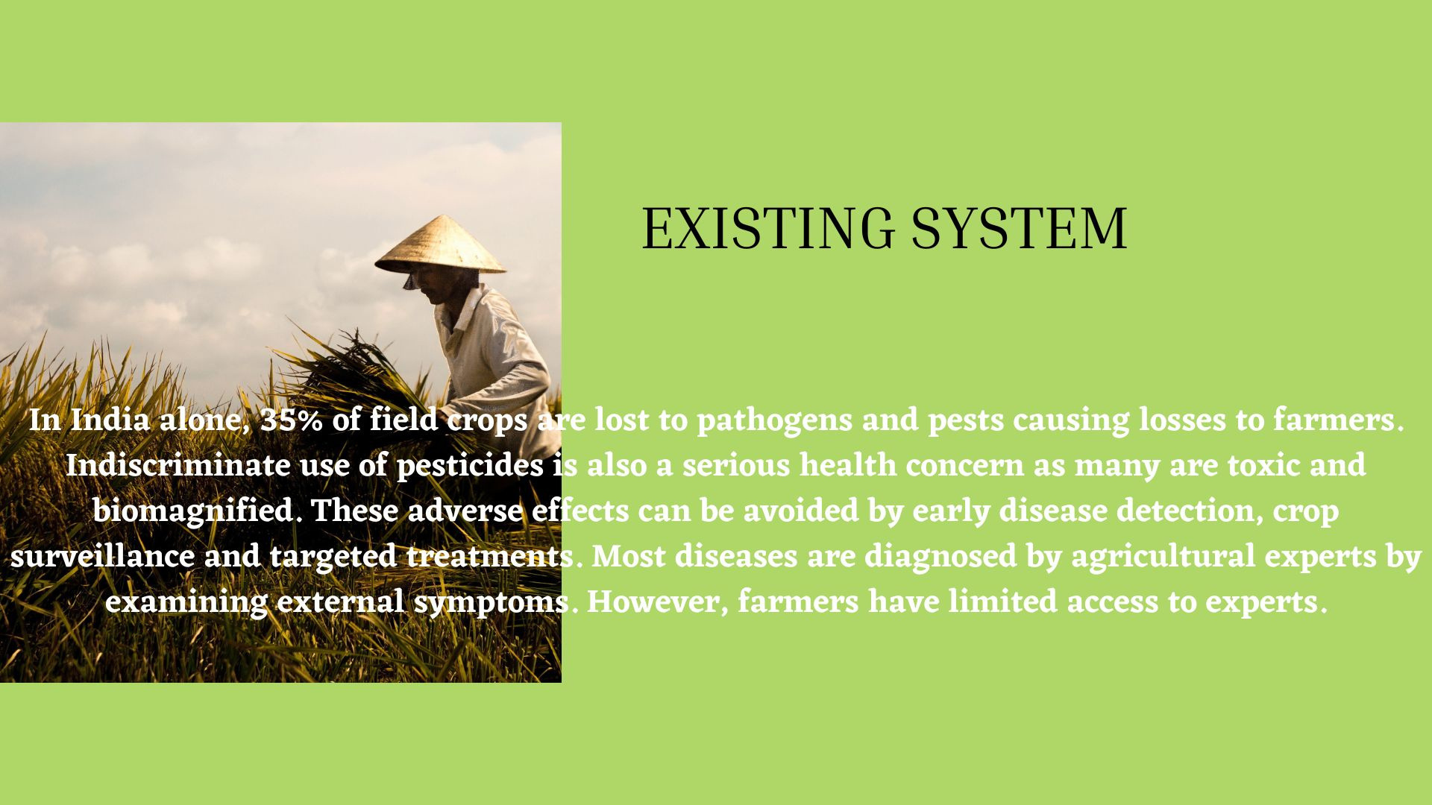

Slide 3
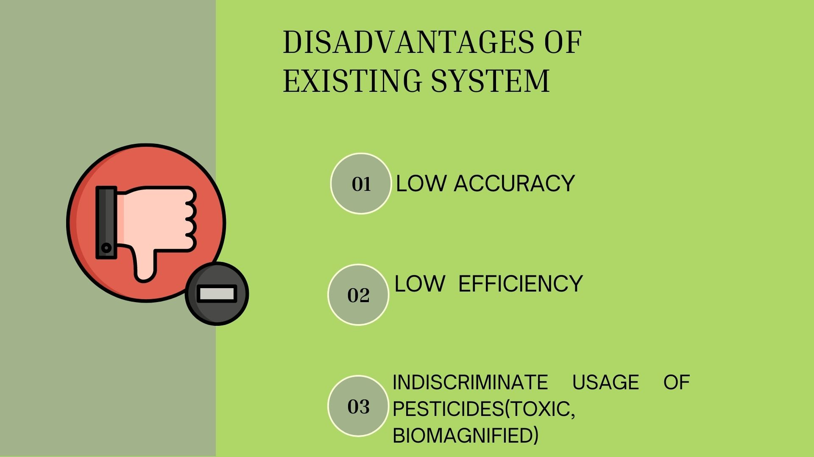

Slide 4
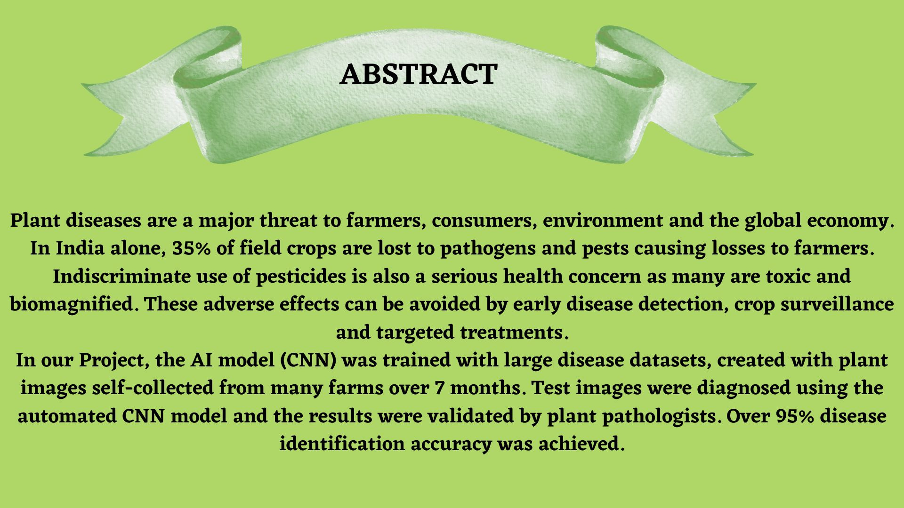
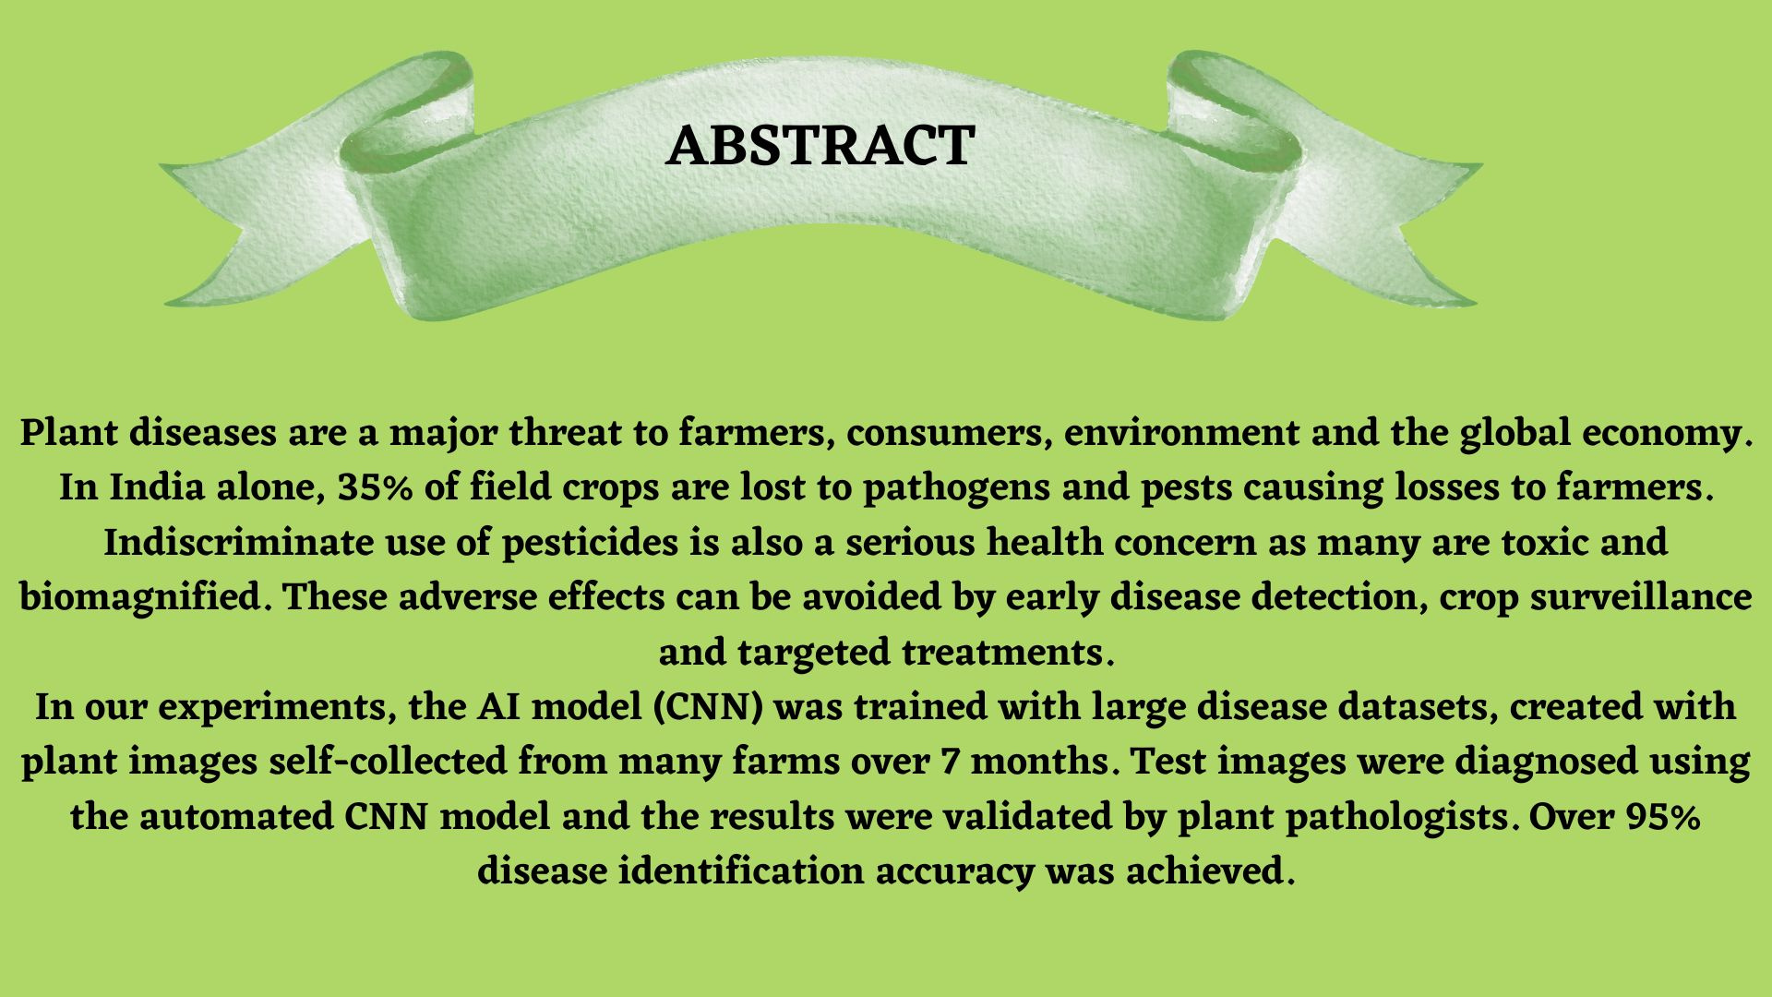
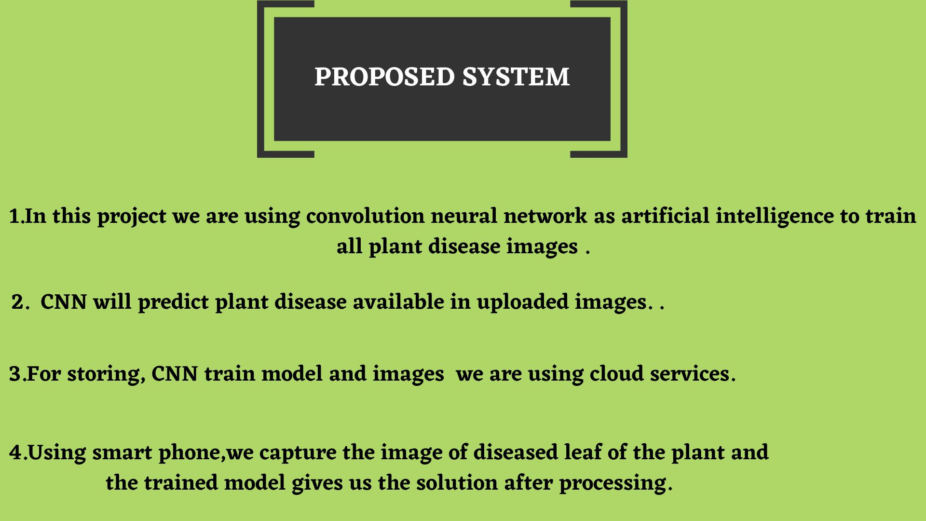

Slide 5
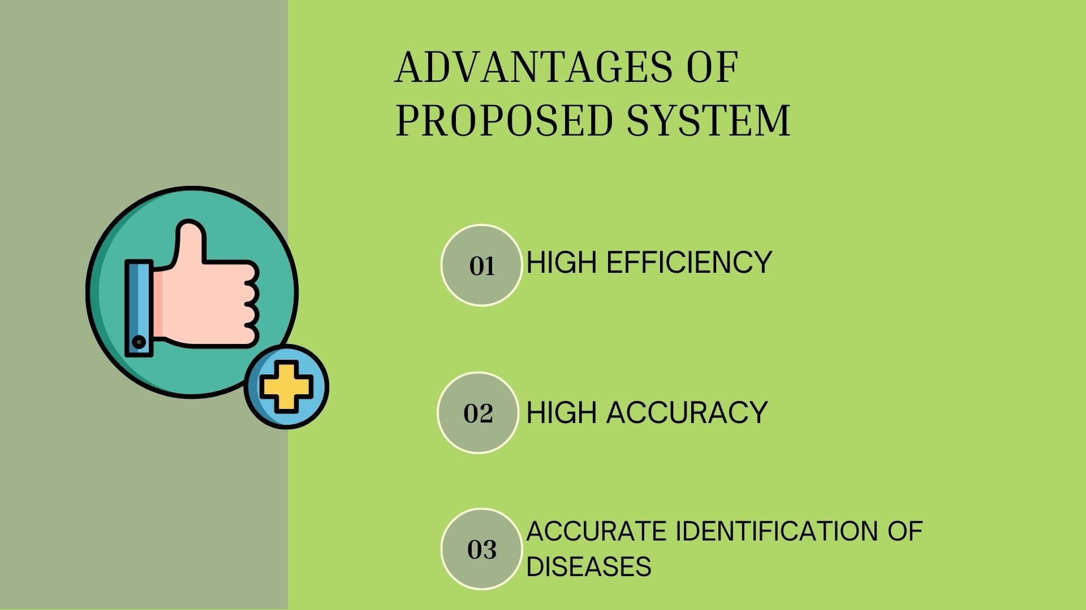

Slide 6
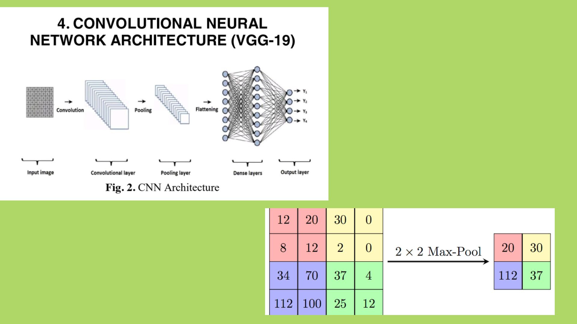
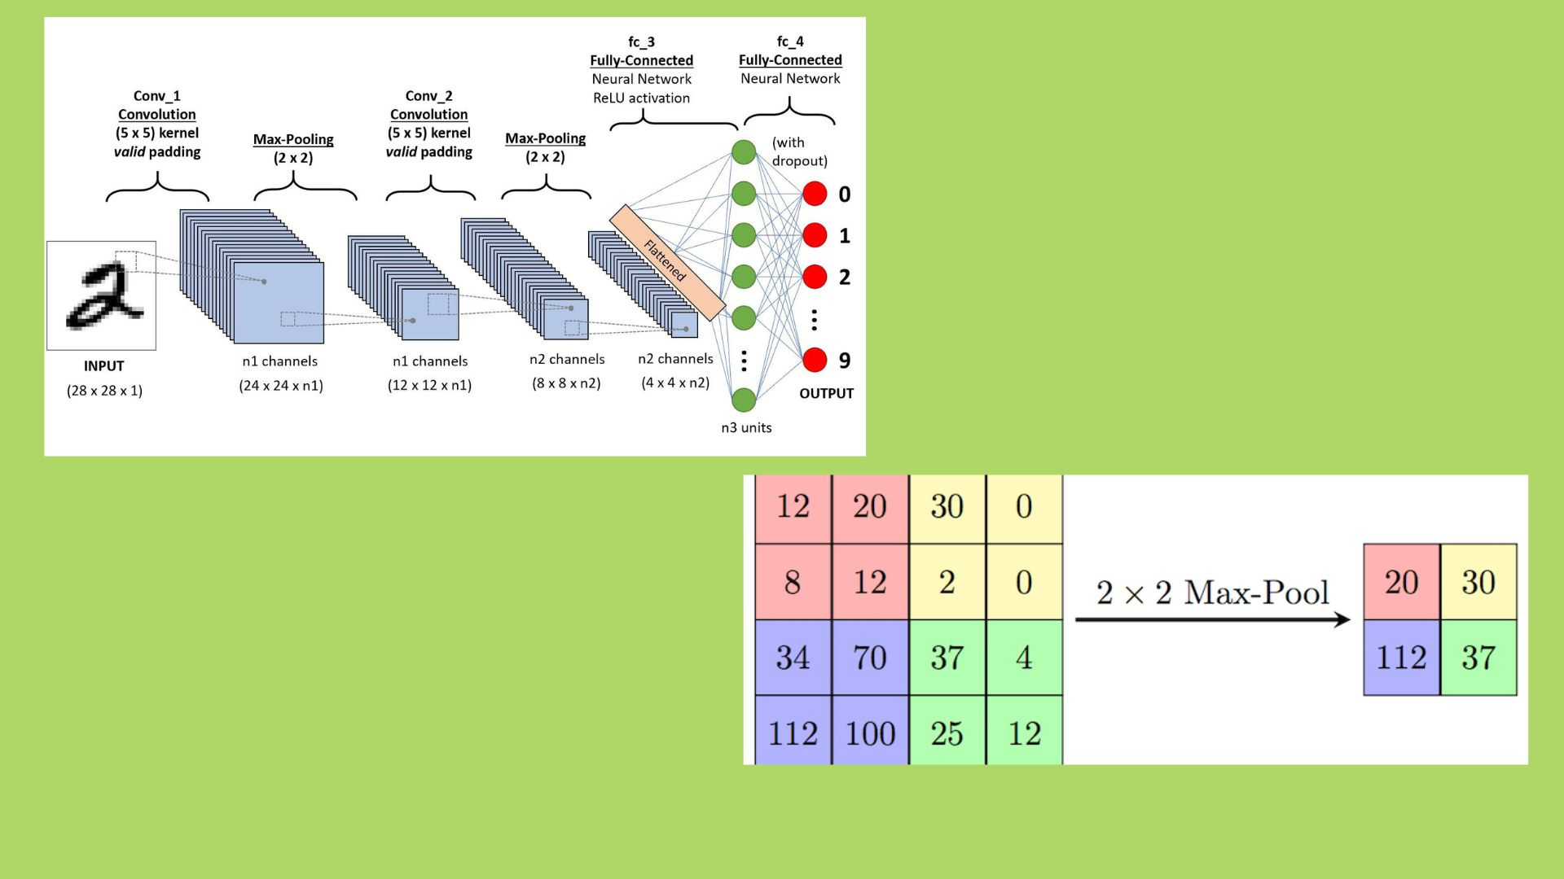

Slide 7


Slide 8


Slide 9
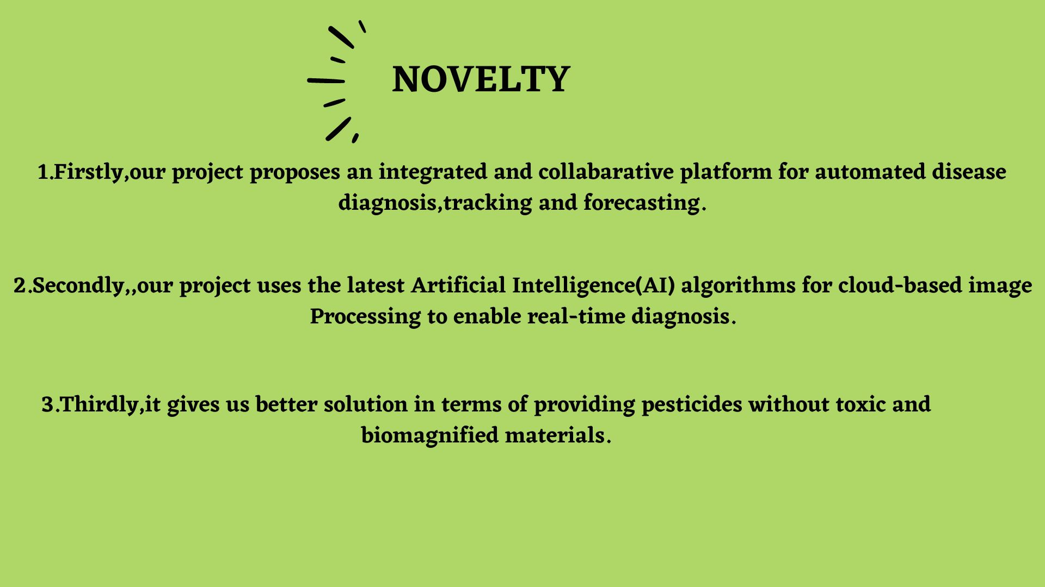

Slide 10


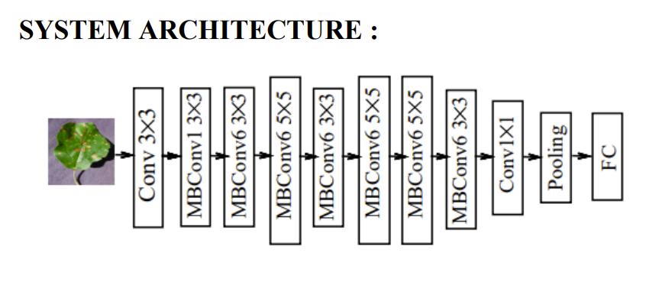
ARCHITECTURE

Slide 11
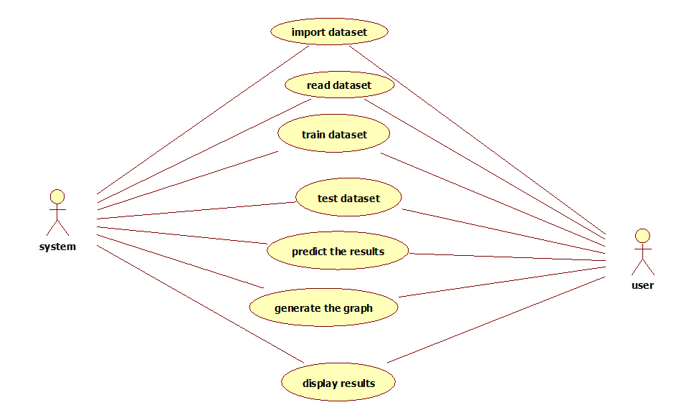
USE CASE DIAGRAM:

Slide 12
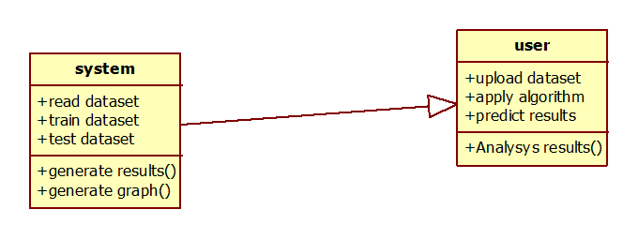
CLASS DIAGRAM:

Slide 13
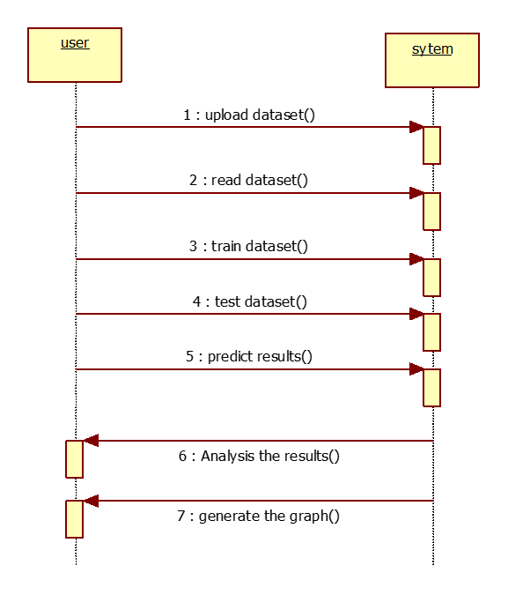
SEQUENCE DIAGRAM:

Slide 14
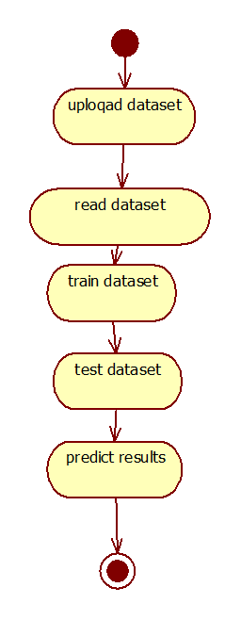
ACTIVITY DIAGRAM:

Slide 15
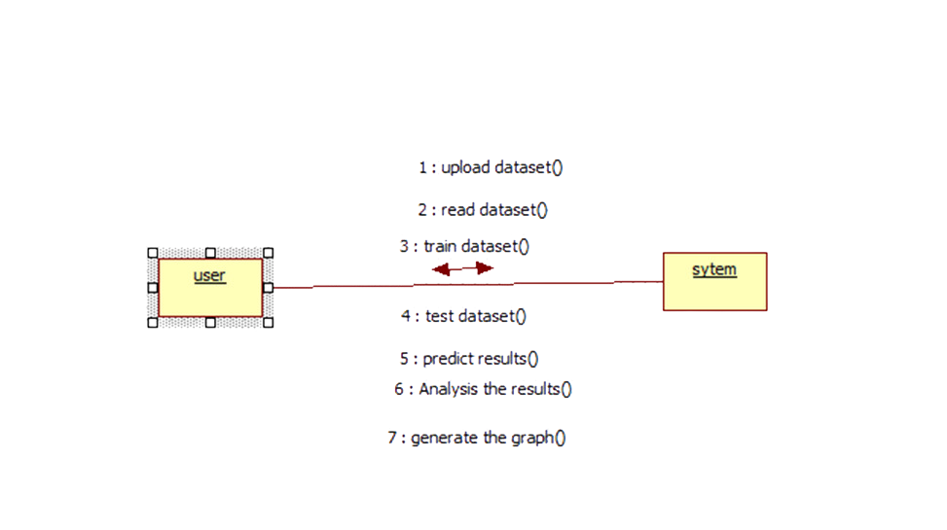
COLLABORATION DIAGRAM:

Slide 16
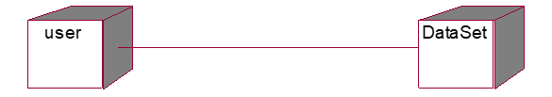
DEPLOYMENT DIAGRAM:

Slide 17
SAMPLE CODE:
import os
import sys
if _name_ == '__main__':
os.environ.setdefault('DJANGO_SETTINGS_MODULE', 'PlantDisease.settings')
try:
from django.core.management import execute_from_command_line
except ImportError as exc:
raise ImportError(
"Couldn't import Django. Are you sure it's installed and "
"available on your PYTHONPATH environment variable? Did you "
"forget to activate a virtual environment?"
) from exc
execute_from_command_line(sys.argv)

Slide 18
SAMPLE CODE:
import os
# Build paths inside the project like this: os.path.join(BASE_DIR, ...)
BASE_DIR = os.path.dirname(os.path.dirname(os.path.abspath(__file__)))
# Quick-start development settings - unsuitable for production
# See https://docs.djangoproject.com/en/2.1/howto/deployment/checklist/
# SECURITY WARNING: keep the secret key used in production secret!
SECRET_KEY = 'tfa4qqytfcxtc@y9y3abkep@^qu9#3o)e+#n*#+j@^2_a=k@-1'
# SECURITY WARNING: don't run with debug turned on in production!
DEBUG = True

Slide 19
SAMPLE CODE:
ALLOWED_HOSTS = []
# Application definition
INSTALLED_APPS = [
'django.contrib.admin',
'django.contrib.auth',
'django.contrib.contenttypes',
'django.contrib.sessions',
'django.contrib.messages',
'django.contrib.staticfiles',
'PlantDiseaseApp'
]

Slide 20
SAMPLE CODE:
MIDDLEWARE = [
'django.middleware.security.SecurityMiddleware',
'django.contrib.sessions.middleware.SessionMiddleware',
'django.middleware.common.CommonMiddleware',
'django.middleware.csrf.CsrfViewMiddleware',
'django.contrib.auth.middleware.AuthenticationMiddleware',
'django.contrib.messages.middleware.MessageMiddleware',
'django.middleware.clickjacking.XFrameOptionsMiddleware',
]
ROOT_URLCONF = 'PlantDisease.urls'
TEMPLATES = [
{
'BACKEND': 'django.template.backends.django.DjangoTemplates',
'DIRS': [

Slide 21
SAMPLE CODE:
os.path.join('D:/MINI PROJECT/B2_PlantDisease/PlantDisease/PlantDiseasep', 'templates'),
],
'APP_DIRS': True,
'OPTIONS': {
'context_processors': [
'django.template.context_processors.debug',
'django.template.context_processors.request',
'django.contrib.auth.context_processors.auth',
'django.contrib.messages.context_processors.messages',
],
},
},
]
WSGI_APPLICATION = 'PlantDisease.wsgi.application'

Slide 22
SAMPLE CODE:
# Database
# https://docs.djangoproject.com/en/2.1/ref/settings/#databases
DATABASES = {
'default': {
'ENGINE': 'django.db.backends.mysql',
'NAME': 'PlantDiseaseDB',
'HOST': '127.0.0.1',
'PORT': '3306',
'USER': 'root',
'PASSWORD': '',
'OPTIONS': {
'autocommit': True,
},
}
}

Slide 23
SAMPLE CODE:
# Password validation
# https://docs.djangoproject.com/en/2.1/ref/settings/#auth-password-validators
AUTH_PASSWORD_VALIDATORS = [
{
'NAME': 'django.contrib.auth.password_validation.UserAttributeSimilarityValidator',
},
{
'NAME': 'django.contrib.auth.password_validation.MinimumLengthValidator',
},
{
'NAME': 'django.contrib.auth.password_validation.CommonPasswordValidator',
},
{
'NAME': 'django.contrib.auth.password_validation.NumericPasswordValidator',
},

Slide 24
SAMPLE CODE:
]
# Internationalization
# https://docs.djangoproject.com/en/2.1/topics/i18n/
LANGUAGE_CODE = 'en-us'
TIME_ZONE = 'UTC'
USE_I18N = True
USE_L10N = True
USE_TZ = True

Slide 25
SAMPLE CODE:
# Static files (CSS, JavaScript, Images)
# https://docs.djangoproject.com/en/2.1/howto/static-files/
STATIC_URL = '/static/'
from django.contrib import admin
from django.urls import path, include
urlpatterns = [
path('admin/', admin.site.urls),
path('', include('PlantDiseaseApp.urls')),
]
import os
from django.core.wsgi import get_wsgi_application
os.environ.setdefault('DJANGO_SETTINGS_MODULE', 'PlantDisease.settings')
application = get_wsgi_application()

Slide 26
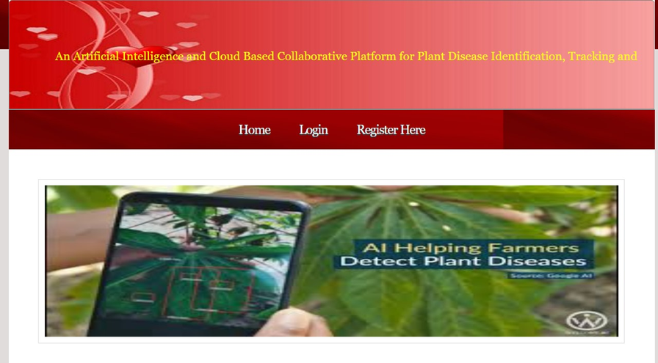
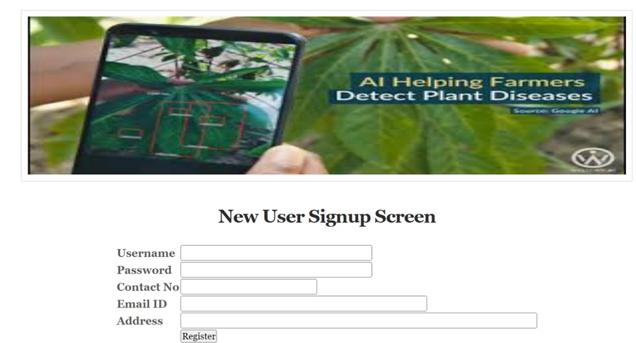
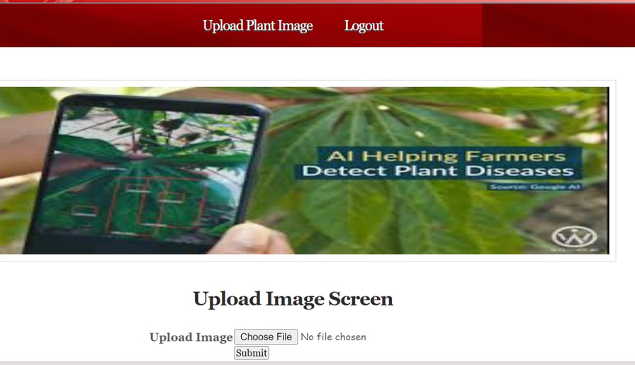
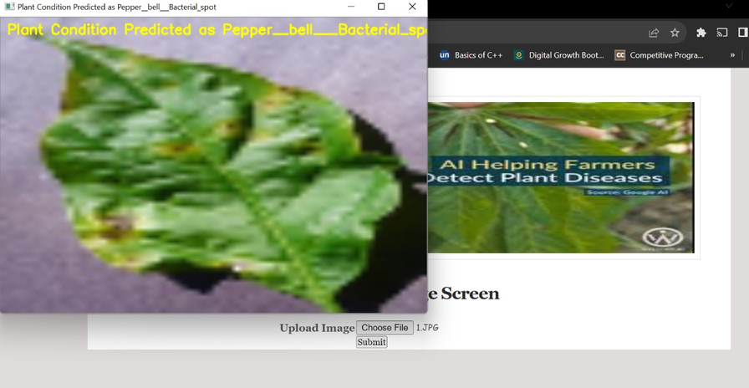
RESULTS:

Slide 27
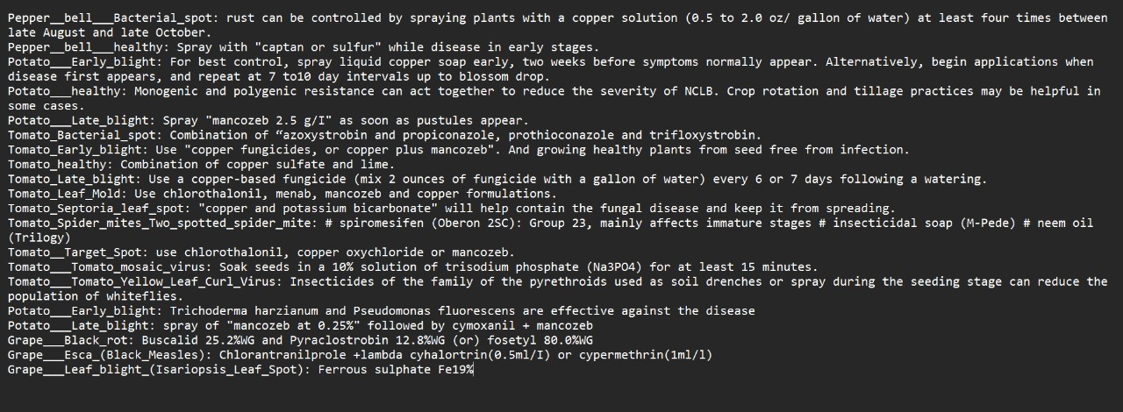
RESULTS:

Slide 28
CONCLUSION:
In conclusion, our project on plant disease identification has successfully demonstrated the potential of machine learning and image recognition techniques to accurately detect and diagnose various plant diseases.
Through extensive data collection, model training, and testing, we have achieved promising results in terms of disease detection accuracy.
This technology holds great promise for farmers and agricultural professionals, as it can help in early disease detection, reducing crop loss, and improving overall crop yield.
However, there is room for further refinement and optimization of the models, and future research should focus on scalability and real-world deployment.
Overall, our project underscores the importance of leveraging technology to address critical challenges in agriculture and enhance food security.

Slide 29
FUTURE SCOPE:
Real-Time Monitoring: Integrating real-time disease monitoring using IoT devices and sensors can enhance your project's practicality. This would allow farmers to continuously monitor their crops and receive immediate alerts when diseases are detected.
Data Collection and Sharing: Establish a platform for farmers to share disease data and images. This collaborative approach can help create a broader dataset, improve model accuracy, and promote knowledge sharing among agricultural communities.
Localization: Adapt your model for different regions and climates. Plant diseases can vary depending on geographical location, so customizing your system for specific regions can be highly beneficial.
Machine Learning Advancements: Keep up with advancements in machine learning and computer vision technologies. Incorporate state-of-the-art algorithms and techniques to improve the accuracy and efficiency of disease identification.
Education and Training: Develop training programs and resources to educate farmers and agricultural workers on how to use your system effectively. Empowering them with the knowledge and skills to identify and manage plant diseases is essential for long-term success.

Slide 30
REFERENCES:
[1] Lee SH, Chan CS, Mayo SJ, Remagnino P. How deep learning extracts and learns leaf features for plant classification. Pattern Recogn. 2017
[2] Kumar S, Singh SK. Occluded thermal face recognition using bag of CNN(BoCNN). IEEE Signal Process Lett. 2020
[3] Kumar S, Kaur R. Plant disease detection using image processing—a review. Int J Comput Appl. 2015;

Slide 31

GITHUB LINK:
https://github.com/Sulakshana3007/Plant-Disease-Detection

Slide 32


